Slide 1
TUTORIAL 6
WORKING WITH XSLT

Slide 2
OBJECTIVES
In this chapter, you will:
Learn about the history and theory of XSL
Create an XSLT style sheet
Be introduced to syntax of the XPath language
Transform an XML document into an HTML file
Create templates to format sections of the XML document

Slide 3
OBJECTIVES
In this chapter, you will:
Sort the contents of an XML document
Create conditional nodes to generate different HTML code
Use predicates to select subsets of an XML document
Insert new elements and attributes in the transformed document

Slide 4
WORKING WITH XSL
In 1998, the W3C developed the Extensible Style sheet Language, or XSL
XSL is composed of three parts:
  XSL-FO (Extensible Style sheet Language – Formatting Objects)
  XSLT (Extensible Style sheet Language Transformations)
  XPath

Slide 5
INTRODUCING XSL-FO, XSLT, AND XPATH
XSL-FO is used to implement page layout and design
XSLT is used to transform XML content into another presentation format
XPath is used to locate information from an XML document and perform operations and calculations upon that content

Slide 6
INTRODUCING XSLT STYLE SHEETS AND PROCESSORS
An XSLT style sheet contains instructions for transforming the contents of an XML document into another format
An XSLT style sheet document is itself an XML document
An XSLT style sheet document has an extension .xsl

Slide 7
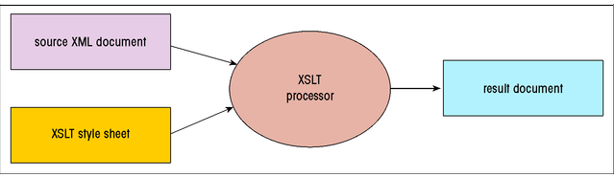
GENERATING A RESULT DOCUMENT
An XSLT style sheet converts a source document of XML content into a result document by using the XSLT processor

Slide 8
INTRODUCING XSLT STYLE SHEETS AND PROCESSORS
The transformation can be performed by a server or a client
In a server-side transformation, the server receives a request from a client, applies the style sheet to the source document, and returns the result document to the client
In a client-side transformation, a client requests retrieval of both the source document and the style sheet from the server, then performs the transformation, and generates the result document

Slide 9
CREATING AN XSLT STYLE SHEET
To create an XSLT style sheet, the general structure:
  <?ml version =“1.0”>
  <xsl:stylesheet version = 1.0
  xmlns:xsl =“http://www.w3.org/1999/XSL/Transform”>
  Content of the style sheet
  </xsl:stylesheet>
  The <xsl:stylesheet> tag can be substituted for the <xsl:transform> tag

Slide 10
WORKING WITH DOCUMENT NODES
Under XPath, each component in the document is referred to as a node, and the entire structure of the document is a node tree
The node tree consists of the following objects:
  the XML document itself
  Comments
  processing instructions
  Namespaces
  elements,
  element text
  element attributes

Slide 11
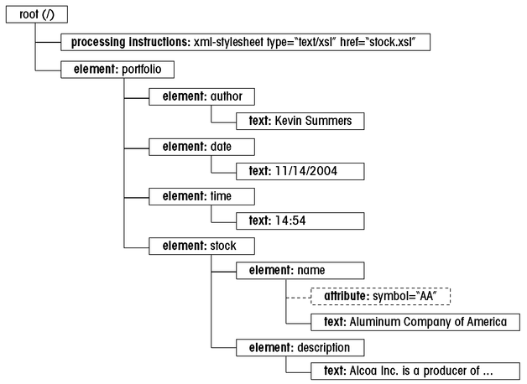
NODE TREE EXAMPLE

Slide 12
WORKING WITH DOCUMENT NODES
At the top of the node is the root node
A node that contains other nodes is called a parent node, and the nodes contained in the parent are called child nodes
Nodes that share a common parent are called sibling nodes
Any node below another node is referred to as a descendant of that node

Slide 13
WORKING WITH DOCUMENT NODES
Nodes are distinguished based on the object they refer to in the document
A node for an element is called an element node
The node that stores element attributes is called an attribute node

Slide 14
USING XPATH TO REFERENCE A NODE
XPath provides the syntax to refer to the various nodes in the node tree
The syntax is used by operation system to specify file pathnames
The location of a node can be expressed in either absolute or relative terms
XPath also does data extraction

Slide 15
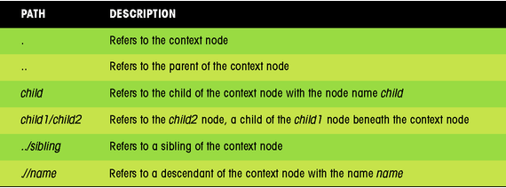
RELATIVE PATHS
With a relative path, the location of the node is indicated relative to a specific node in the tree called the context node

Slide 16
USING XPATH TO REFERENCE A NODE
For absolute path, XPath begins with the root node, identified by a forward slash and proceeds down the levels of the node tree
An absolute path: /child1/child2/child3/…
To reference an element without regard to its location in the node tree, use a double forward slash with the name of the descendant node
A relative path : //descendant

Slide 17
REFERENCING GROUPS OF ELEMENTS
XPath allows you to refer to groups of nodes by using the wildcard character (*)
To select all of the nodes in the node tree, you can use the path:
//*
The (*) symbol matches any node, and the (//)symbol matches any level of the node tree
Example: /portfolio/stock/*

Slide 18
REFERENCING ATTRIBUTE NODES
XPath uses different notation to refer to attribute nodes
The syntax for attribute node is:
@attribute
where attribute is the name of the attribute
Example: /portfolio/stock/name/@symbol

Slide 19
WORKING WITH TEXT NODES
The text contained in an element node is treated as a text node
The syntax for selecting a text node is:
@text()
To match all text nodes in the document, use:
//text()

Slide 20
CREATING THE ROOT TEMPLATE
A template is a collection of elements that define how a particular section of the source document should be transformed in the result document
The root template sets up the initial code for the result document

Slide 21
CREATING A ROOTTEMPLATE
To create a root template, the syntax is:
  <xsl:template match=“/”>
  XSLT and Literal Result Elements
  </xsl:template>

Slide 22
CREATING A TEMPLATE
To create a template, the syntax is:
  <xsl:template match=“node”>
  XSLT and Literal Result Elements
  </xsl:template>
  where node is either the the name of a node from the source document’s node tree, or an XPath expression that points node in the tree

Slide 23
CREATING THE ROOT TEMPLATE
A template contains two types of content: XSLT elements and literal result elements
  XSLT elements are those elements that are part of the XSLT namespace and are used to send commands to the XSLT processor
  A literal result element is text sent to the result document, but not acted upon by the XSLT processor

Slide 24
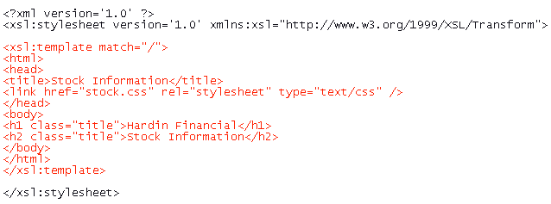
CREATING THE ROOT TEMPLATE EXAMPLE

Slide 25
SPECIFYING THE OUTPUT METHOD
By default, the XSLT processor will render the result document as an XML file
To control how the processor formats the source document, you can specify the output method using the <xsl:output/> element

Slide 26
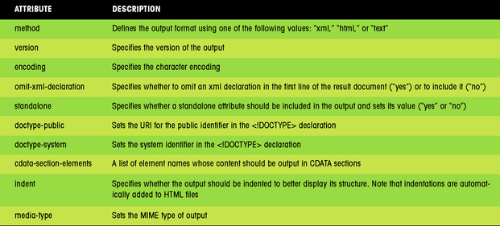
ATTRIBUTS OF THE <XSL:OUTPUT/> ELEMENT

Slide 27
TRANSFORMING A DOCUMENT
A browser with a built-in XSLT processor allows you to view the result document
Alternatively, you can use XML Spy to create the result document as a separate file, and then view that file in your browser
Most XSLT processors provide the capability to create the result document as a separate file

Slide 28
VIEWING THE RESULT DOCUMENT IN A BROWSER
Internet Explorer 6.0 contains built-in XSLT processor
You can view the results of the transformation by opening the result document in the browser

Slide 29
CREATING AN HTML FILE IN XML SPY
One advantage of creating a separate HTML file is that it can be viewed in any Web browser
You have to regenerate the HTML file every time you make a change to the source document, or the style sheet
The XSLT processor adds one extra line to the document that provides additional information to the browser about the content of the document and its encoding

Slide 30
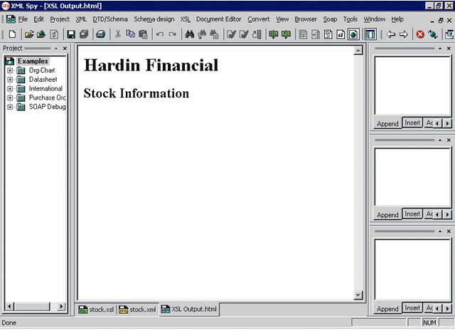
TRANSFORMING THE SOURCE DOCUMENT IN XML SPY

Slide 31
INSERTING A NODE VALUE
To insert a node’s value into the result document, the syntax is:
  <xsl:value-of> select=“XPath Expression” />
  where XPath Expression is an expression that identifies the node from the source document’s node tree
If the node contains child elements in addition to text content, the text in those child nodes appears as well

Slide 32
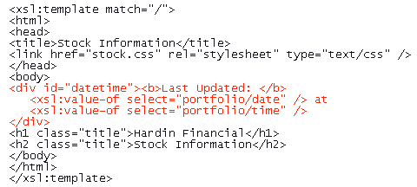
INSERTING A NODE VALUE EXAMPLE

Slide 33
PROCESSING A BATCH OF NODES
To process a batch of nodes, the syntax is:
  <xsl:for-each select=“XPath Expression” />
  XSLT and Literal Elements
  </xsl:for-each>
  where XPath Expression is an expression that defines the group of nodes to which the XSLT and literal result elements are applied

Slide 34
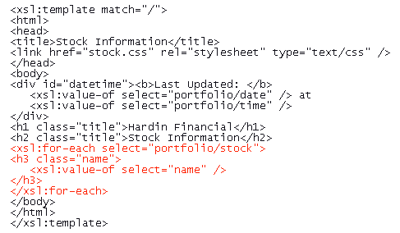
PROCESSING A BATCH OF NODES EXAMPLE

Slide 35
WORKING WITH TEMPLATES
To apply a template in the result document, use the XSLT element
  <xsl:apply-templates select=“XPath Expression” />
  where XPath Expression indicates the node template to be applied

Slide 36
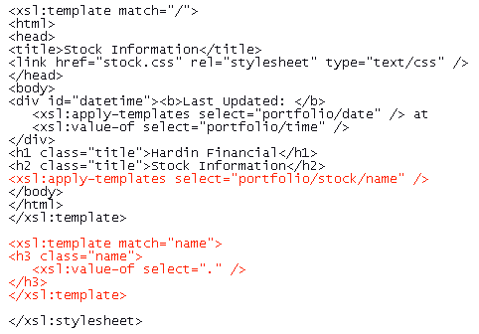
CREATING TEMPLATE EXAMPLE

Slide 37
USING THE BUILT-IN TEMPLATES
Each node has its own built-in template.
The built-in template for element nodes matches the document root and all elements in the node tree
The built-in template for text nodes matches all text nodes and causes their values to appear in the result document
For example, you can add the stock template to the style sheet

Slide 38
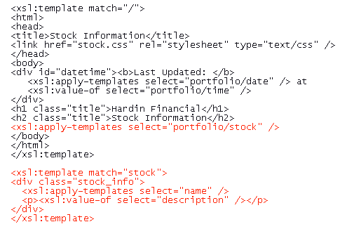
CREATING THE STOCK TEMPLATE EXAMPLE

Slide 39
SORTING NODES
By default, nodes are processed in document order, by their appearance in the document
To specify a different order, XSLT provides the <xsl:sort> element
This element can be used with either the <xsl:apply-templates> or the <xsl:for-each> element

Slide 40

SORTING NODES
The <xsl:sort> element contains several attributes to control how the XSLT process sorts the nodes in the source document
  The select attribute determines the criteria under which the context node is sorted
  The data-type attribute indicates the type of data
  The order attribute indicates the direction of the sorting (ascending or descending)

Slide 41
CREATING CONDITIONAL NODES
XSLT supports two kinds of conditional elements:
  <xsl:if>
  <xsl:choose>
To apply a format only if a particular condition is met , use the <xsl:if> element
To test for multiple conditions and display different outcomes, use the <xsl:choose> element

Slide 42
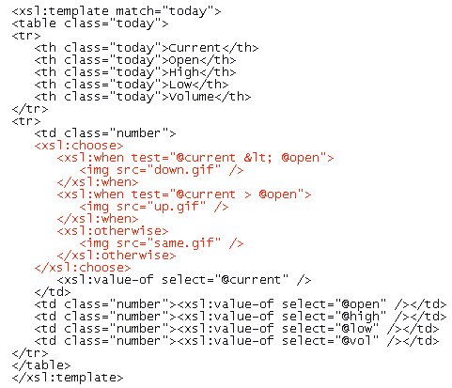
CREATING CONDITIONAL NODES EXAMPLE

Slide 43
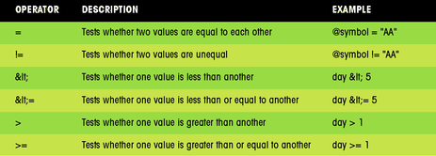
USING COMPARISON OPERATORS AND FUNCTIONS

Slide 44
WORKING WITH PREDICATES
Predicates are XPath expressions that test for a condition and create subsets of nodes that fulfill that condition
The predicate can also indicate the position of the node in the node tree
To select a specific position in the source document, use the position() function combined with any XPath expression

Slide 45
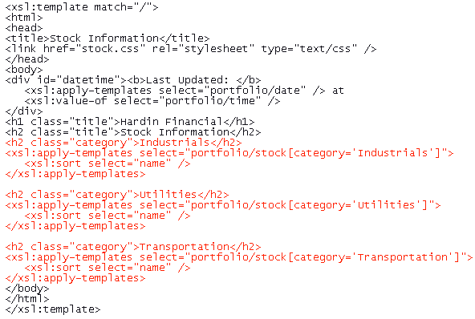
ADDING PREDICATES TO THE ROOT TEMPLATE EXAMPLE

Slide 46
CREATING ELEMENTS AND ATTRIBUTES
To create an element, XSLT uses the <xsl:element> tag
The namespace attribute assigns a name to the element
The namespace attribute provides a namespace
The use-attribute provides a list of attribute-sets

Slide 47
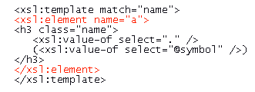
CREATING AN ELEMENT
To create the <a> element in the result document, use the <xsl:element> tag

Slide 48
CREATING AN ATTRIBUTE
Attributes are created in XSLT by using the <xsl:attribute> element
The name attribute specifies the name of the attribute
The namespace attribute indicates the namespace
You can create inline images in the result document by using the attribute tag

Slide 49
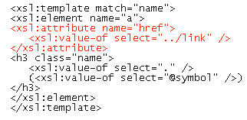
CREATING AN ATTRIBUTE
To add the href attribute to the <a> tag, use the <xsl:attribute> element

Slide 50

CREATING COMMENTS AND PROCESSING INSTRUCTIONS
The <xsl:comment> element creates the comment
You can create a processing instruction by using the <xsl:processing-instruction> element
If you want to add a processing instruction to attach the result document to the style.css sheet, use the following code:

Slide 51
SUMMARY
Extensible Style sheet Language,or XSL, is composed of three parts: XSL-FO, XSLT, and XPath
XPath language is used to reference a node
Templates are used to format sections of the XML document and transform XML data into a variety of formats

Slide 52
SUMMARY
Nodes can be sorted in either alphabetical or numerical order
Comparison elements allow changing the contents of the result document based on the values of the nodes in the source document
Predicates are used to create subsets of the source document’s node tree
You can insert new elements and attributes in the transformed document

